Slide 1
Floating Point Representation
CSE-3109 Computer Architecture
Lecture 15

Slide 2
Need for floating point number
The range of number represented by a fixed-point number is insufficient for many applications, particularly, when very large and very small numbers are required.
Scientific notation allows to represent such numbers using relatively few digits.
For example, it is easier to write 1.0 x 10¹⁸ than
1 000 000 000 000 000 000

Slide 3
Need for floating point number
The main difference between fixed point and floating point is that the fixed point has a specific number of digits reserved for the integer part and fractional part while the floating point does not have a specific number of digits reserved for the integer part and fractional part.

Slide 4
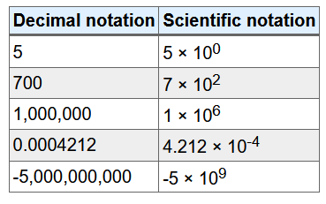
Need for floating point number
The range of number represented by a fixed-point

Slide 5
Basic Format of Floating-Point Number
Three numbers are associate with a floating-point number: a mantissa M, an exponent E and a base B. The mantissa M is also referred to as the significant or fraction in the literature.
A real number is represented as M × B^{E}.
Example: 1.0 × 10¹⁸ where 1.0 = mantissa, 10 = base and 18 = exponent.

Slide 6
Representation of Floating-Point Number
A floating point number is represented as a word (M,E) consisting of a pair of signed fixed-point numbers: M, which is usually a fraction or integer and E, which is an integer.
Since, B is constant, it is not stored but is simply built into the circuit that process the number.
The number of digits in M determines the precision (accuracy) of (M,E); B and E determines the range.

Slide 7
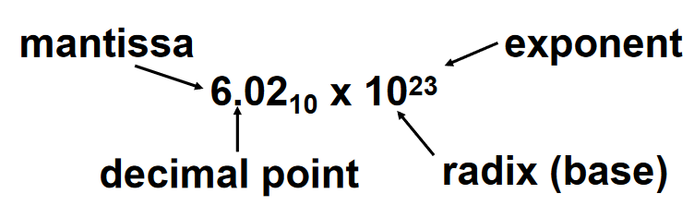
Representation of Floating-Point Number

Slide 8
Scientific Notation
Scientific notation (also referred to as standard form or standard index form) is a way of expressing numbers that are too big or too small to be conveniently written in decimal form.
In scientific notation all numbers are written in the form:
  m × 10^{n}
(m times ten raised to the power of n), where the exponent n is an integer, and the coefficient m is any real or integer number called the mantissa.)

Slide 9
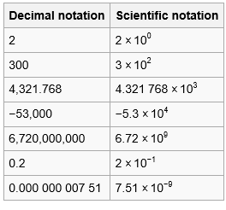
Example of Scientific Notation

Slide 10
Normalized Notation
Any given integer can be written in the form m×10^{n} in many ways: for example, 350 can be written as 3.5×10² or 35×10¹ or 350×10⁰.
In normalized scientific notation (called "standard form" in the UK), the exponent n is chosen so that the absolute value of m remains at least one but less than ten (1 ≤ |m| < 10).
Thus 350 is written as 3.5×10².
The 10 and exponent are often omitted when the exponent is 0.

Slide 11
Normalized Notation
Scientific notation, as many people may remember, is a method of writing out large or small numbers, as a normalized fraction, and a multiplier.
The term normalized, in this case, means that the magnitude (absolute value) of the number is between 1 and 10.
If the number we have lies outside this range, we multiply or divide by successive powers of 10, as necessary, until the fractional part of the number is within that range.

Slide 12



Normalized Notation
Let's say that we have a large number: 123,456,789 in scientific notation, we want to divide this by a power of 10, To do this, we divide by 100,000,000 (hundred million), and we get the final result:
Now, to express our original number, we have to multiply this fractional number times the amount we divided by originally:
And for ease, we frequently write the last term as an exponent of 10:

Slide 13
Binary Numbers in Scientific Notation
Just as we can show decimal numbers in scientific notation, we can also show binary numbers in scientific notation:
1.0_{two} × 2⁻¹
Since the point is called a "decimal point" in a decimal (base 10) number system, it is common to refer to the same exact point as a "binary point" when in a binary system.
Just as in scientific notation, numbers are represented as a single nonzero digit to the left of the binary point. In binary, the form is
1.xxxxxxxxx_{two} × 2^{yyyy}

Slide 14
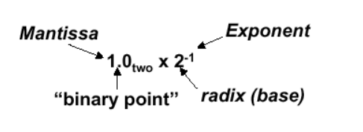
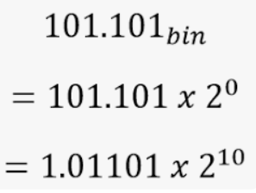
Binary Numbers in Scientific Notation

Slide 15
Example
Represent 1001011 into binary product form.
And our normalized number:
Now, we can write the final binary product as:

Slide 16
Normalizing the Mantissa
Before a floating-point binary number can be stored correctly, its mantissa must be normalized. The process is basically the same as when normalizing a floating-point decimal number. For example, decimal 1234.567 is normalized as 1.234567 × 10³ by moving the decimal point so that only one digit appears before the decimal.
Similarly, the floating-point binary value 1101.101 is normalized as 1.101101 × 2³ by moving the decimal point 3 positions to the left, and multiplying by 2³.

Slide 17
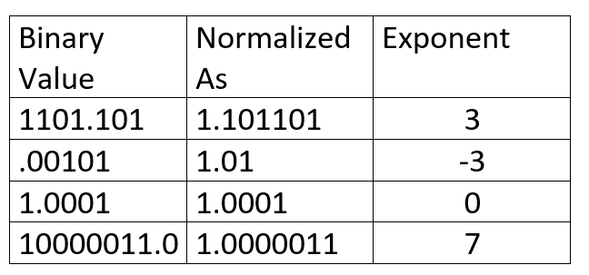

Normalizing the Mantissa

Slide 18
Floating Point Representation
A designer of a floating-point representation must find a compromise between the size of the fraction and the size of the exponent, because a fixed word size means you must take a bit from one to add a bit to the other.
  Increasing the size of the fraction enhances the precision of the fraction
  Increasing the size of the exponent increases the range of numbers that can be represented.

Slide 19
Precision and Accuracy
Precision is a count of the number of bits in a computer word used to represent a value.
  Capacity for accuracy
Accuracy is a measure of the difference between the actual value of a number and its computer representation.

Slide 20
Precision and Accuracy
High precision permits high accuracy but doesn’t guarantee it. It is possible to have high precision but low accuracy.
Example: float pi = 3.14;
pi will be represented using all 24 bits of the mantissa (highly precise), but is only an approximation (not accurate)

Slide 21

IEEE 754 Floating Point Number
Found in virtually every computer invented since 1980
s is the sign of the floating-point number (1 meaning negative),
exponent is the value of the 8-bit exponent field (including the sign of the exponent)
fraction is the 23-bit number
This representation is called sign and magnitude, since the sign is a separate bit from the rest of the number.

Slide 22
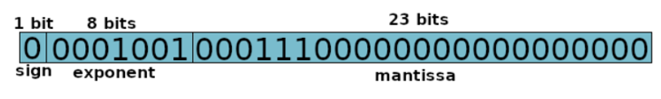
IEEE 754 Floating Point Number-Continue
Floating-point numbers are of the form
(-1)^{S} × F × 2E
F involves the value in the fraction field and E involves the value in the exponent field;

Slide 23
IEEE 754 Floating Point Number-Special Cases (Special Cases: 0, ±∞, and NaN)
The IEEE floating-point standard has special cases to represent numbers such as zero, infinity, and illegal results. For example, representing the number zero is problematic in floating-point notation because of the implicit leading one. Special codes with exponents of all 0’s or all l’s are reserved for these special cases.

Slide 24
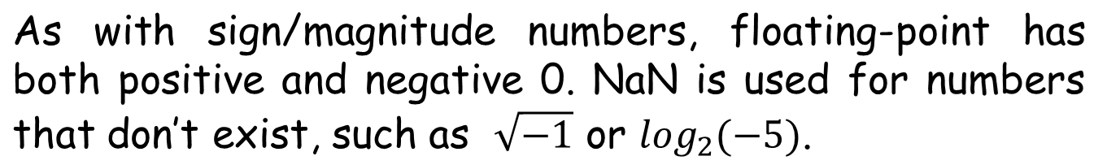
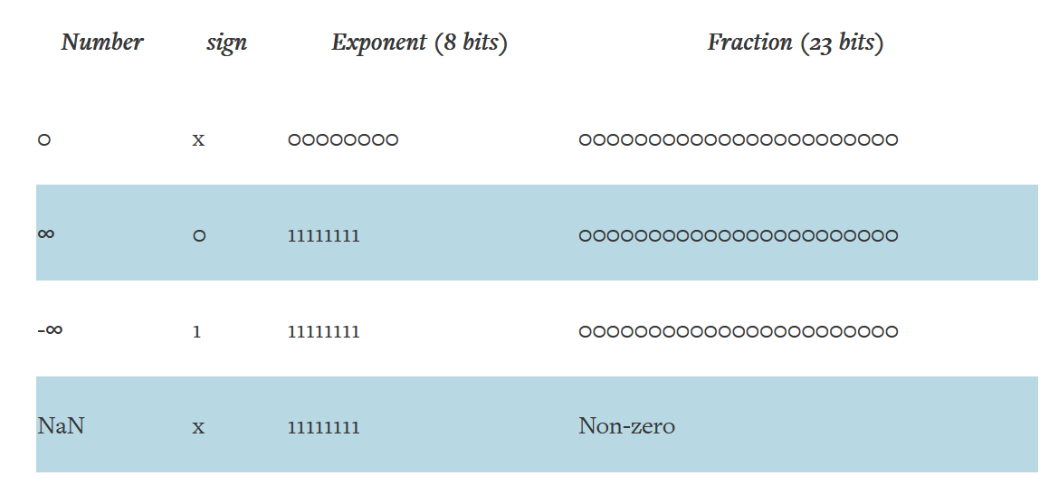
IEEE 754 Floating Point Number-Special Cases (Special Cases: 0, ±∞, and NaN)

Slide 25
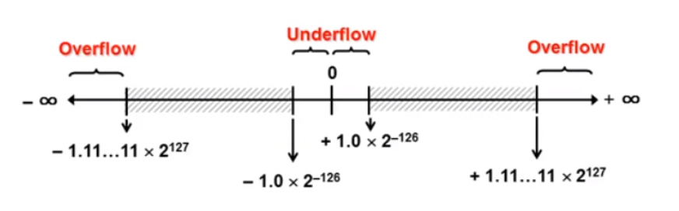
Underflow and Overflow in floating point number
Overflow and underflow are both errors resulting from a shortage of space.
Overflow: Exponent larger than represented in 8-bit Exponent field.
Underflow: Negative exponent larger than represent in 8-bit field.

Slide 26
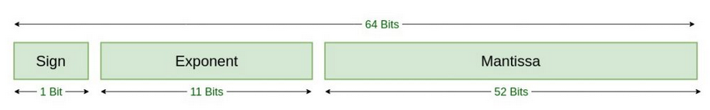
Double precision
One way to reduce chances of underflow or overflow is to offer another format that has a larger exponent.
Double-precision floating-point format, on the other hand, occupies 64 bits of computer memory and is far more accurate than the single-precision format.
Although double precision allows for more accuracy, it also requires more computational resources, memory storage, and data transfer. The cost of using this format doesn’t always make sense for every calculation.

Slide 27
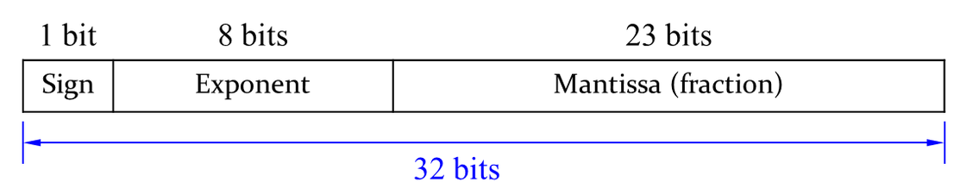

Floating Point Number representation
We will show you how to represent the decimal number 228₁₀ using a 32-bit floating point representation. There are three versions. The final version is called the IEEE 754 floating-point standard.
First, we need to convert the decimal number to the binary number.

Slide 28




Floating Point Number representation
After getting the binary number, we can write the binary number in “binary scientific notation”.
where, we can identify
The mantissa
The base
and the exponent

Slide 29
Floating Point Number representation
Let’s fill in each field of the 32-bit floating point number:
The sign bit is positive (0)
The 8-bit exponent represents the value 7: 00000111
The remaining 23 bits are the mantissa: 11100100000000000000000

Slide 30
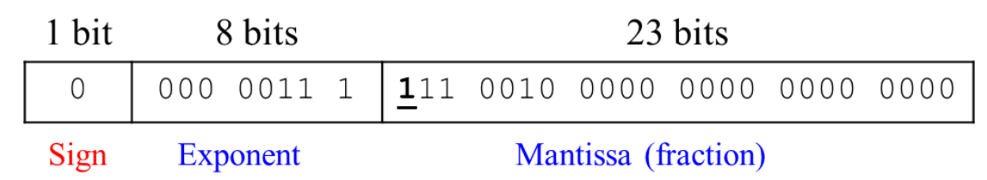
Floating Point Number representation
Since the mantissa has a total of 6 digits in the given example. The rest of the mantissa will be filled with ‘0’. The following figure show the first representation of the floating-point number.
The first bit of the mantissa is always ‘1’. The implicit leading one is not included in the 23-bit mantissa for efficiency. We only store the fraction bits in 23-bit field except the leading one. The following figure shows the second representation of the floating-point number.

Slide 31
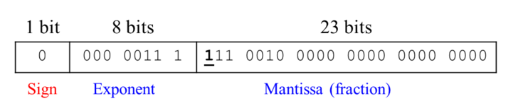
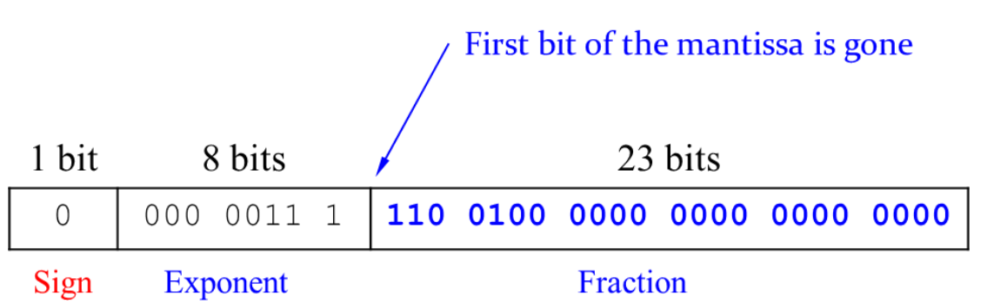
Floating Point Number representation
Notice that the first bit of the mantissa is gone. Now we only store the fraction.

Slide 32
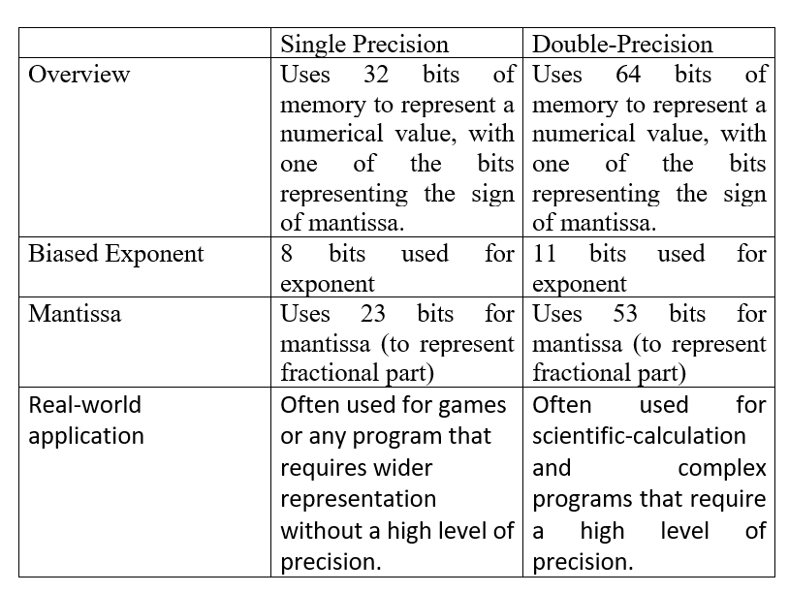
Comparison between single precision and Double Precision

Slide 33
IEEE 754 Floating Point Number-Continue
To pack even more bits into the significand, IEEE 754 makes the leading 1-bit of normalized binary numbers implicit.
Hence, the number is actually 24 bits long in single precision (implied 1 and a 23-bit fraction), and 53 bits long in double precision (1 + 52).
To be precise, we use the term significand to represent the 24- or 53-bit number that is 1 plus the fraction, and fraction when we mean the 23- or 52-bit number.

Slide 34
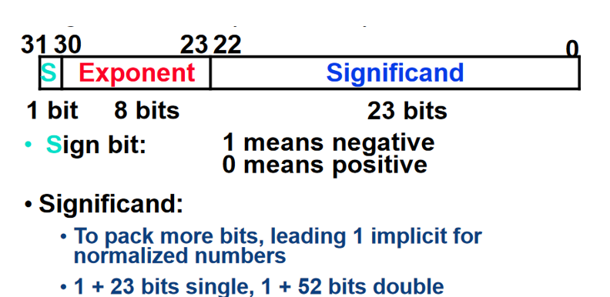
IEEE 754 Floating Point Number-Continue
Significant will be always 0 or 1.

Slide 35
IEEE 754 Floating Point Number-Continue
Since 0 has no leading 1, it is given the reserved exponent value 0 so that the hardware won’t attach a leading 1 to it.
Thus 00 . . . 00_{two} represents 0; the representation of the rest of the numbers uses the following form hidden 1 added:
(-1)^{S} × (1 + Fraction) × 2E

Slide 36
IEEE 754 Floating Point Number-Continue
(-1)^{S} × (1 + Fraction) × 2E
where the bits of the fraction represent a number between 0 and 1 and E specifies the value in the exponent field. If we number the bits of the fraction from left to right s1, s2, s3, . . . , then the value is

Slide 37

Biased Notation
Negative exponents could pose a problem in comparisons.
For example (with two's complement):
With this representation, the first exponent shows a "larger" binary number, making direct comparison more difficult.
To avoid this, Biased Notation is used for exponents.

Slide 38
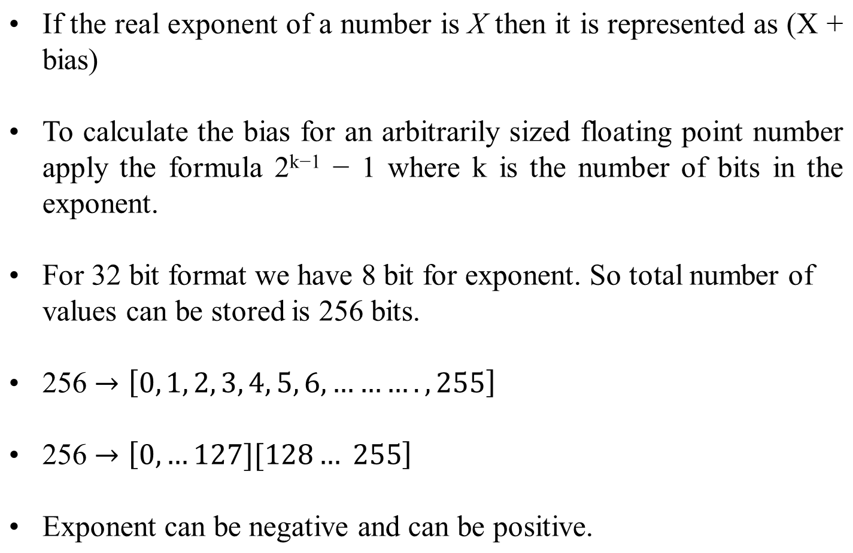
Biased Notation-continue

Slide 39
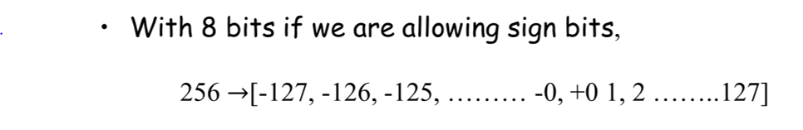
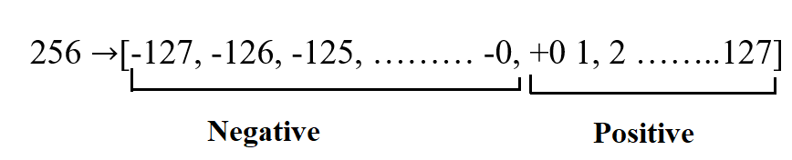
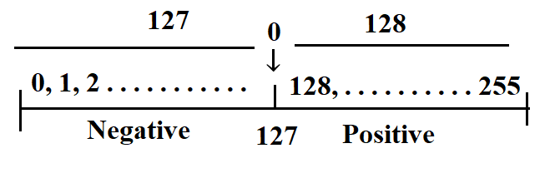
Biased Notation-continue
Thus, an exponent of zero means that 127 is stored in the exponent field.

Slide 40
Biased Notation-continue
For a single-precision number, the exponent is stored in the range 1 .. 254 (0 and 255 have special meanings), and is interpreted by subtracting the bias for an 8-bit exponent (127) to get an exponent value in the range −126 .. +127.
For a double-precision number, the exponent is stored in the range 1 .. 2046 (0 and 2047 have special meanings), and is interpreted by subtracting the bias for an 11-bit exponent (1023) to get an exponent value in the range −1022 .. +1023.With 8 bits if we are allowing sign bits,

Slide 41
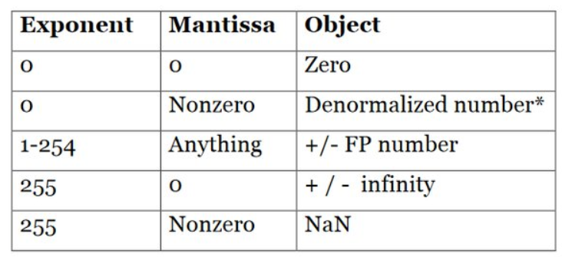
Biased Notation-continue
A number is denormalized if the exponent field contains all 0's and the fraction field does not contain all 0's.

Slide 42
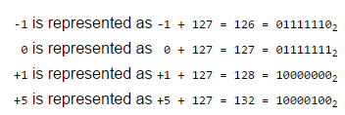
Biased Notation-continue
IEEE single-precision uses a bias of 127.
Therefore, an exponent of

Slide 43
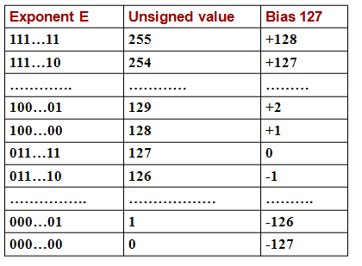
Biased Notation-continue
So the actual exponent is found by subtracting the bias from the stored exponent.
(-1)^{S}×(1+Fraction)×2^{(Exponent-Bias)}

Slide 44
Converting from Decimal to Binary Floating Point
What is the binary representation for the single-precision floating point number that corresponds to X = -12.25₁₀?
What is the normalized binary representation for the number?
-12.25₁₀ = -1100.01₂ = -1.10001₂ × 2³
What are the sign, stored exponent, and normalized mantissa?
S = 1 (since the number is negative)
E = 3 + 127 = 130 = 10000010₂
M = 10001000000000000000000₂
X = 11000001010001000000000000000000₂

Slide 45
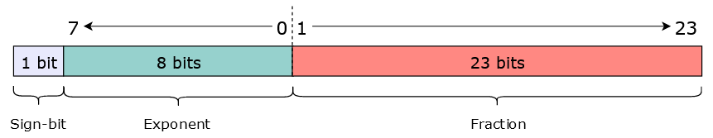
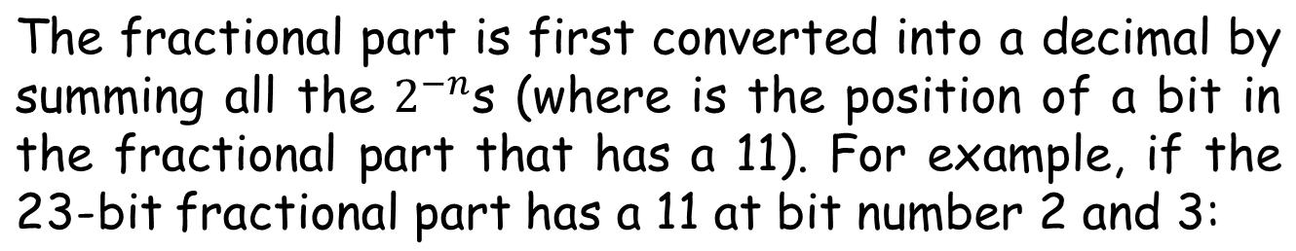
How to convert a single-precision binary float to decimal
A single-precision binary float is represented using 32-bits. These bits are divided into three sections to represent the sign, exponent, and fractional parts of a decimal number (according to the IEEE 754 standard).

Slide 46
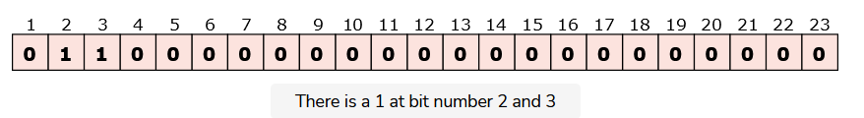

How to convert a single-precision binary float to decimal
Its decimal equivalent would be:

Slide 47

Formula
Applying the following formula will convert the whole 32-bit binary number into a decimal,
, where, s is the sign-bit, Fraction is the value that has been computed above as an example, and exp is the numerical value, in base 10, of the 8-bits reserved for the exponent.

Slide 48
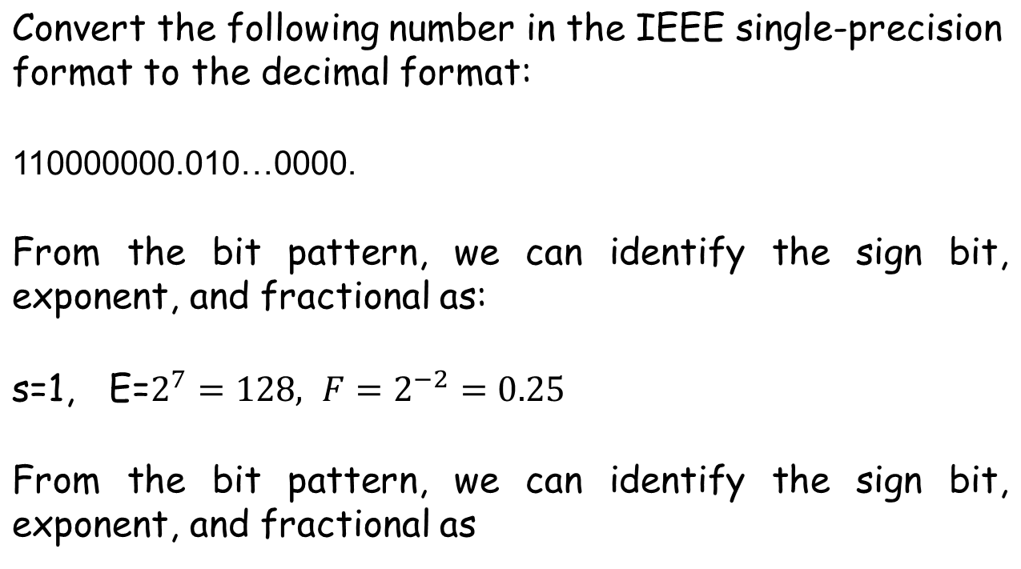
Example

Slide 49
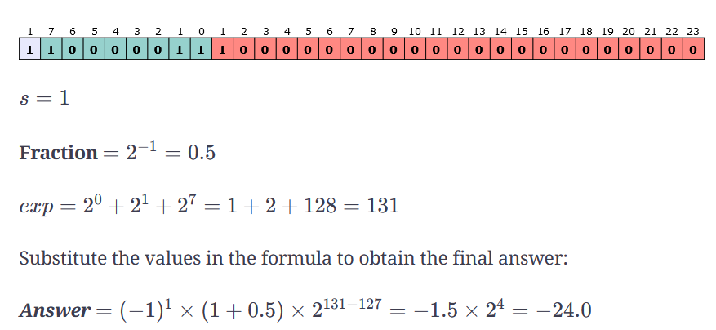
Example

Slide 50
Example
What number is represented by the single-precision float
11000000101000…00
  S = 1
  Fraction = 01000…00₂
  Exponent = 10000001₂ = 129
x = (–1)¹ × (1 + (2⁻²)) × 2^{(129 – 127)}
= (–1) × 1.25 × 2²
= –5.0

Slide 51

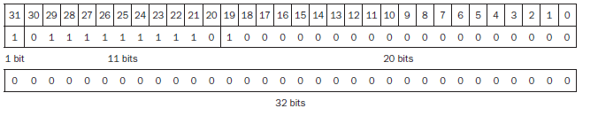
Do it yourself
Show the IEEE 754 binary representation of the number -0.75_{ten} in single and double precision.
Answer

Slide 52

Do it yourself
What decimal number is represented by this single precision float?
Answer
-5.0

Slide 53
End

